Slide 1
Create objects

Slide 2
Contents
Create User
Create Group
Managing Objects
Implementing and Managing OUs

Slide 3
Create Domain User
Active Directory Users and Computers
Active Directory Administrative Center
Windows Power Shell
Directory command line tool dsadd

Slide 4
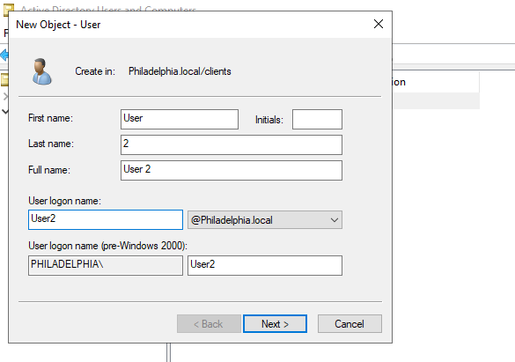
Create Object
Active Directory Users and Computers

Slide 5
User Attributes

Slide 6
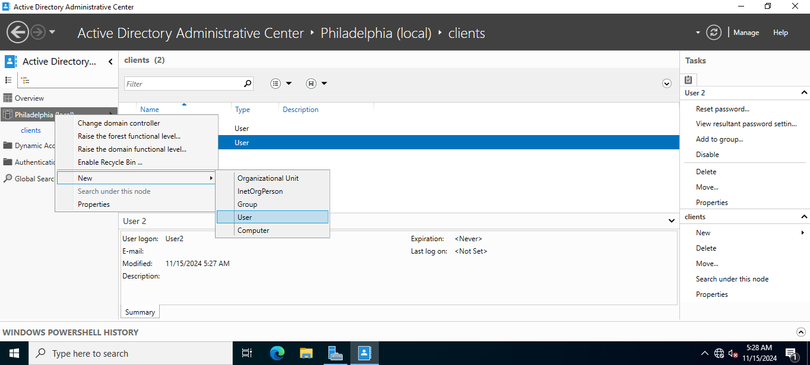
Create user
Active Directory Administrative Center

Slide 7
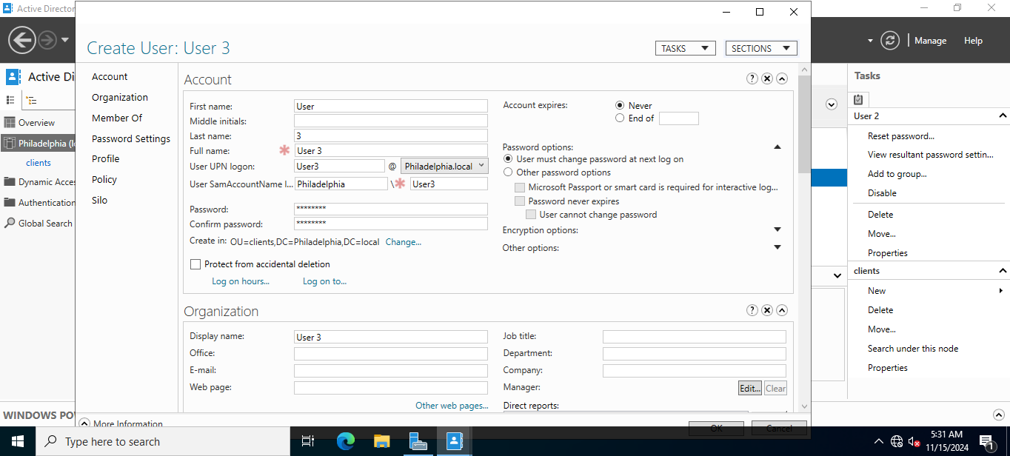
User Attributes

Slide 8
Create User
Command line dsadd
Dsadd
user “cn=John Smith,
ou=SouthEmployees,
dc=northwindtraders,
dc=com”
-disabled no
–pwd C^h3Bdo9#
-mustchpwd yes
-memberof cn=janitors,
ou=SouthEmployees,
dc=northwindtraders,
dc=com
-acctexpires never

Slide 9
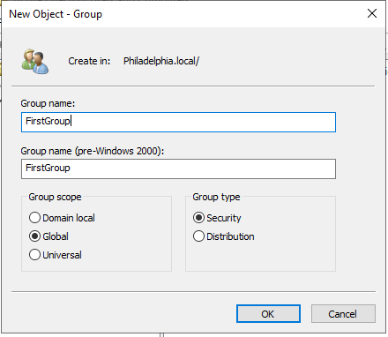
Create Group

Slide 10
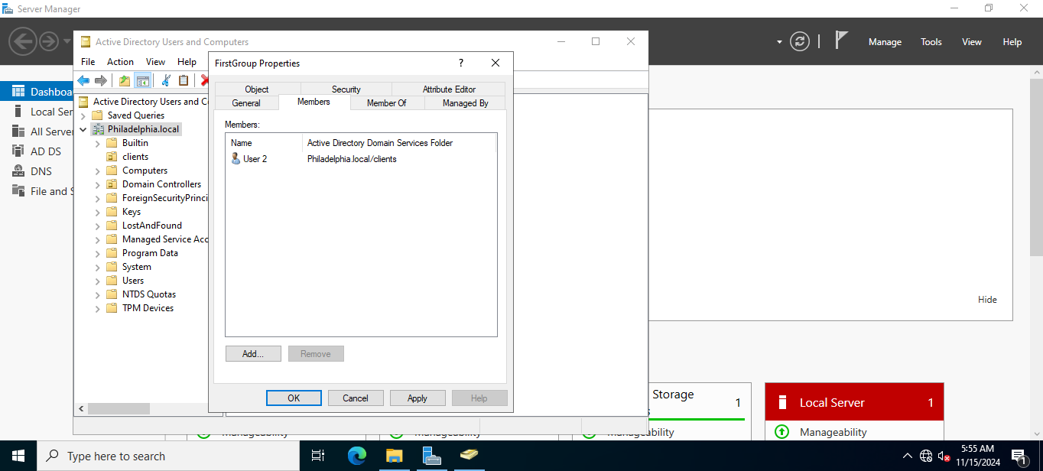
Mange Group

